Slide 1
PSYC 741 Hierarchical Linear Modeling
Session 6 – Moderation and interactions in multilevel models

Slide 2
Overview of Today’s Class
Lecture and Discussion
Review of Moderation in Regression Models
Interaction Effects in Multilevel Models
R tutorial
Interaction effects in R
Plotting interaction effects

Slide 3
Review of Moderation in Regression Models
Overview of moderation in regression models
Equation and example output
Interpreting the main effects and interaction term
Plotting interaction effects and simple slope analysis
Other important issues

Slide 4
Moderation: Definition and Terms
What is moderation?
Moderation is when the relationship between two variables (X and Y) depends on the level of another variable (W).
(Symmetrical: also true that the relationship between W and Y depends on X)

Slide 5
Moderation: Definition and Terms
What are some other terms that should make you think that moderation might be occurring?
Conditional effect
Effect modification
“depending on…”
“modified by”
Exacerbated
Enhanced
Sensitized
Suppressed
Habituated
Buffered
Cross-over effect
Interaction

Slide 6

Think of an Example
Any examples of moderation that apply to YOUR research area?

Slide 7
Moderation in Regression
When can you look at moderation in a regression analysis? (i.e., what combination of variables do you need?)
DV: continuous
IVs: 2+
Continuous
Dichotomous
3+-level categorical recoded as dummy codes
i.e., same exact combination as multiple linear regression
Moderation can be looked at with ANY combination of 2 (or more) of the IVs

Slide 8
Moderation in Regression
Same equation, just with an additional term…
Here’s a regression equation with 2 variables
Y = A + B₁X₁ + B₂X₂

Slide 9
Moderation in Regression
Same equation, just with an additional term…
Let’s name one variable X (the “independent variable” and the other W (the “moderator”)
Y = A + B₁X + B₂W

Slide 10
Moderation in Regression
Same equation, just with an additional term…
Regression equation in moderation includes an additional term that is the product of X and W (i.e., X*W, or just XW), and that has its own beta weight
Y = A + B₁X + B₂W + B₃XW

Slide 11
survey.sav data
DV: Optimism (Moptim)
IV1: Age (in years)
IV2: Sex (0 = males, 1 = females)
Research Question: Is the relationship between age and optimism moderated by sex?

Slide 12
survey.sav data
Research question: Is the relationship between age and optimism moderated by sex?
As written, which is the independent variable, and which is the moderator variable?
X = age
W = sex

Slide 13
Moderation Example: Output
Model Summary: R², ΔR², ΔF
ANOVA: Overall F at each step
Coefficients
Step 1: Effects of age and sex without interaction; these are often termed main effects or unconditional effects
Step 2: Ditto (these are now called conditional effects) and interaction
FYI: since we only added one variable, ΔR² is equivalent to the squared semi-partial correlation of the interaction term

Slide 14
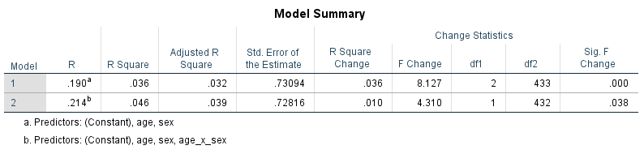
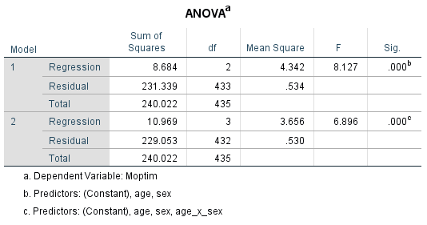
Moderation Example: Output

Slide 15
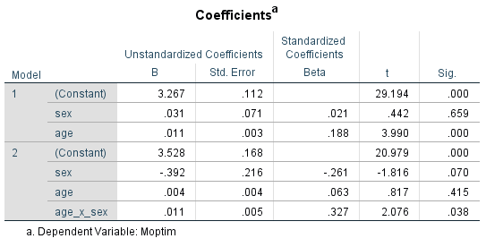
Moderation Example: Output

Slide 16
What do B₁, B₂, and B₃ mean?
Depends (sort of) on whether two IVs are dichotomous or continuous
I say “sort of” because same principles apply, but examples “look” different
Let’s look at the general principle first and then go back to the combos of variables

Slide 17
Let’s rewrite our equation in terms of X
Y = A + B₁X + B₂W + B₃XW
Y = A + B₂W + (B₁ + B₃W)X
What is the effect of X on Y when W = 0?

Slide 18
Let’s rewrite our equation in terms of X
Y = A + B₁X + B₂W + B₃XW
Y = A + B₂W + (B₁ + B₃W)X
What is the effect of X on Y when W = 0?
B₁
Each unit increase in X is associated with a B₁ increase in Y when W=0
This is termed the conditional effect of X (when W = 0)

Slide 19
Let’s rewrite our equation in terms of X
Y = A + B₁X + B₂W + B₃XW
Y = A + B₂W + (B₁ + B₃W)X
What is the effect of X on Y when W = 1?
B₁ + B₃
Each unit increase in X is associated with a (B₁ + B₃) increase in Y when W=1
This is the conditional effect of X on Y when W = 1

Slide 20
Let’s rewrite our equation in terms of X
Y = A + B₁X + B₂W + B₃XW
Y = A + B₂W + (B₁ + B₃W)X
How much does the effect of X on Y change with each unit increase in W?
B₃
With each unit increase in W, the relationship between X and Y changes by B₃.

Slide 21
Summary of general principles
Y = A + B₁X + B₂W + B₃XW
Y = A + B₂W + (B₁ + B₃W)X
What does this tell us about the effect of X on Y?
When W is 0, the effect of X on Y is B₁
When W is 1, the effect of X on Y is B₁ + B₃
With each unit increase in W, the effect of X on Y increases by B₃
Now, let’s turn to the specific combos of variables…

Slide 22
Dichotomous (X) + Dichotomous (W)
When both coded as 0 and 1, you don’t even really have to consider the general principles (although they still apply)
Let’s look at what happens when we plug the four possible combinations of X and W into the equation…

Slide 23
Dichotomous (X) + Dichotomous (W)
Y = A + B₁X + B₂W+ B₃XW
X | W | Y (with zero terms eliminated)
0 | 0 | A
1 | 0 | A + B1
0 | 1 | A + B2
1 | 1 | A + B1 + B2 + B3

Slide 24
Continuous (X) + Dichotomous (W)
Principles #1 and #2 are key to this combination
When W is 0, the effect of X on Y is B₁
When W is 1, the effect of X on Y is B₁ + B₃
With each unit increase in W, the effect of X on Y increases by B₃

Slide 25
Class Example
X = age
W = sex (0 = male, 1 = female)
Y = optimism
B₁ = the conditional effect of X on Y when W is 0
B₁ = 0.004 (SE = 0.004)
For males, each additional year is associated with a 0.004 unit increase in optimism

Slide 26
Class Example
X = age
W = sex (0 = male, 1 = female)
Y = optimism
B₁ + B₃ = the conditional effect of X on Y when W is 1
B₁ + B₃ = 0.004 + (0.011) = 0.015
For females, each additional year in age is associated with a 0.015 increase in optimism

Slide 27
Class Example
X = age
W = sex (0 = male, 1 = female)
Y = optimism
B₃ = the change in the effect of X on Y with each unit increase in W
B₃ = 0.011 (SE = 0.005)
The difference in the effect of a year of age on optimism between males and females is 0.011

Slide 28
Dichotomous (X) + Continuous (W)
All three principles become important here
When W is 0, the effect of X on Y is B₁
When W is 1, the effect of X on Y is B₁ + B₃
With each unit increase in W, the effect of X on Y increases by B₃

Slide 29
Class Example
Let’s switch things around so that we can look at this combination
W = age
X = sex (0 = male, 1 = female)
Y = optimism
Now, we are looking at whether age moderates the effect of sex on optimism
Results are the same; moderation is symmetrical

Slide 30
Continuous Moderators
B₁ = the conditional effect of (X=1) on Y when W is 0
Issue that comes up here: substantive meaning of W = 0
Ask yourself
Is a 0 score on your continuous variable even possible?
If it is possible, is it meaningful?

Slide 31
Continuous Moderators
B₁ = the conditional effect of (X=1) on Y when W is 0
Issue that comes up here: substantive meaning of W = 0
Our continuous W is Age
Is this meaningful?

Slide 32
How to make W=0 meaningful?
Centering
Make “0” a score that has substantive meaning
Most common = mean centering
Make “0” the mean score

Slide 33
Back to our Example: Centering
Let’s center age (W)
This will change the B (i.e., B₁) for sex only.
First, find mean of variable:
Analyze → Descriptives
Enter age
M = 37.44

Slide 34
Dichotomous (X) + Continuous (W)
First, compute mean of age
Second, compute mean-centered variable
Transform → Compute
Name new variable: age_cent
Compute as age - 37.44
Third, re-compute interaction (age_cent_x_sex)
Fourth, re-run regression analysis

Slide 35
Continuous (X) + Continuous (W)
B1 = the conditional effect of X on Y when W is 0
B3 = how much the effect of X on Y changes with each one-unit increase in W
i.e., same deal!
Mean center W if W=0 is not meaningful
Since moderation is symmetrical, also mean center X if X=0 is not meaningful…

Slide 36
Continuous (X1) + Continuous (X2)
B₁ = the conditional effect of X1 on Y when X2 is 0
B₂ = the conditional effect of X2 on Y when X1 is 0
B₃ = how much the effect of X1 on Y changes with each one-unit increase in X2
B₃ = ALSO how much the effect of X2 on Y changes with each one-unit increase on X1
Mean center X1 and X2 if (X1=0) and/or (X2=0) not meaningful, respectively

Slide 37
Bottom line on Centering
Mean centering is often used because means are usually meaningful
You could center at another value if that value is meaningful
You can re-run your analysis with, e.g., W centered at different values
Will change the value and interpretation of B₁ only
B₁ will be the effect of X on Y at whatever the “centered” value of W is
Centering at different values can be useful in interpreting an interaction effect (to be discussed later)

Slide 38
Have you heard anything else about centering?
Often said that the purpose of centering is to reduce multicollinearity between, e.g., X and XW
Multicollinearity → funky outcomes (e.g., model won’t run; giant standard errors)
It DOES reduce multicollinearity… but it does not always solve “funkiness”

Slide 39
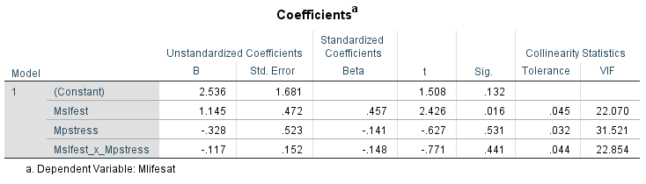
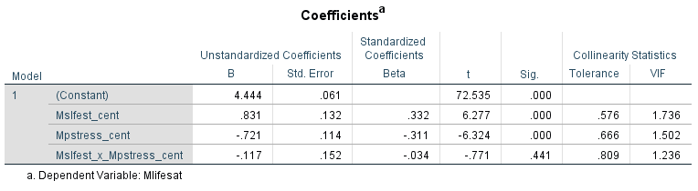
Have you heard anything else about centering?
Below tables demonstrate that centering reduces multicollinearity
Notes:
Centering -> DOESN’T affect the interaction term
Centering -> DOES affect the main effects

Slide 40
Graph your Interaction
Choose values of X and W that make sense (easy if X and W are dichotomous)
Plug these values into your regression equation
If you have a strong feeling about which IV is X and which is W
Graph 1
X on x-axis; Y on Y-axis
Lines that represent different values of W

Slide 41
How to graph
Choose values of X and W that make sense (easy if X and W are dichotomous)
Plug these values into your regression equation
If you don’t have a strong feeling about which is the moderator, make 2 graphs and see which is more illuminating
Graph 1
X on x-axis; Y on Y-axis
Lines that represent different values of W
Graph 2
W on x-axis; Y on Y-axis
Lines that represent different values of X

Slide 42
Graphing
Y = A + B₁X + B₂W+ B₃XW
Optimism = 3.528 + 0.004(age) - 0.392(female sex) + 0.011(age X sex)
Let’s plug some values into an Excel sheet

Slide 43
Graphing
age | Sex (1= female) | optimism
20 | 0 | 3.608
50 | 0 | 3.728
80 | 0 | 3.848
20 | 1 | 3.436
50 | 1 | 3.886
80 | 1 | 4.336

Slide 44
Graphing
Interpretation: for females, increases in age are associated with higher optimism; for males, no relationship between age and optimism

Slide 45
Wait, is that it?!
No, there’s even more!
At what values of W is the effect of X on Y statistically significant? What values is it not statistically significant?

Slide 46
Simple Slope Approach
Look within your full sample at whether the effect of X on Y (i.e., B₁ + B₃) is significant at a few specific levels of W
Called a spotlight analysis, simple slopes analysis, or pick-a-point approach
If W is continuous, center W at different values and look at significance of B₁

Slide 47
Floodlight approach (for continuous W)
Look within your full sample at whether the effect of X on Y (i.e., B1 + B3) is significant at many different levels of W
Called a floodlight analysis
Aka Johnson-Neyman approach
Uses the critical value of t to determine range of values on W where the relationship between X and Y is significant
Called the zone of significance or region of significance

Slide 48
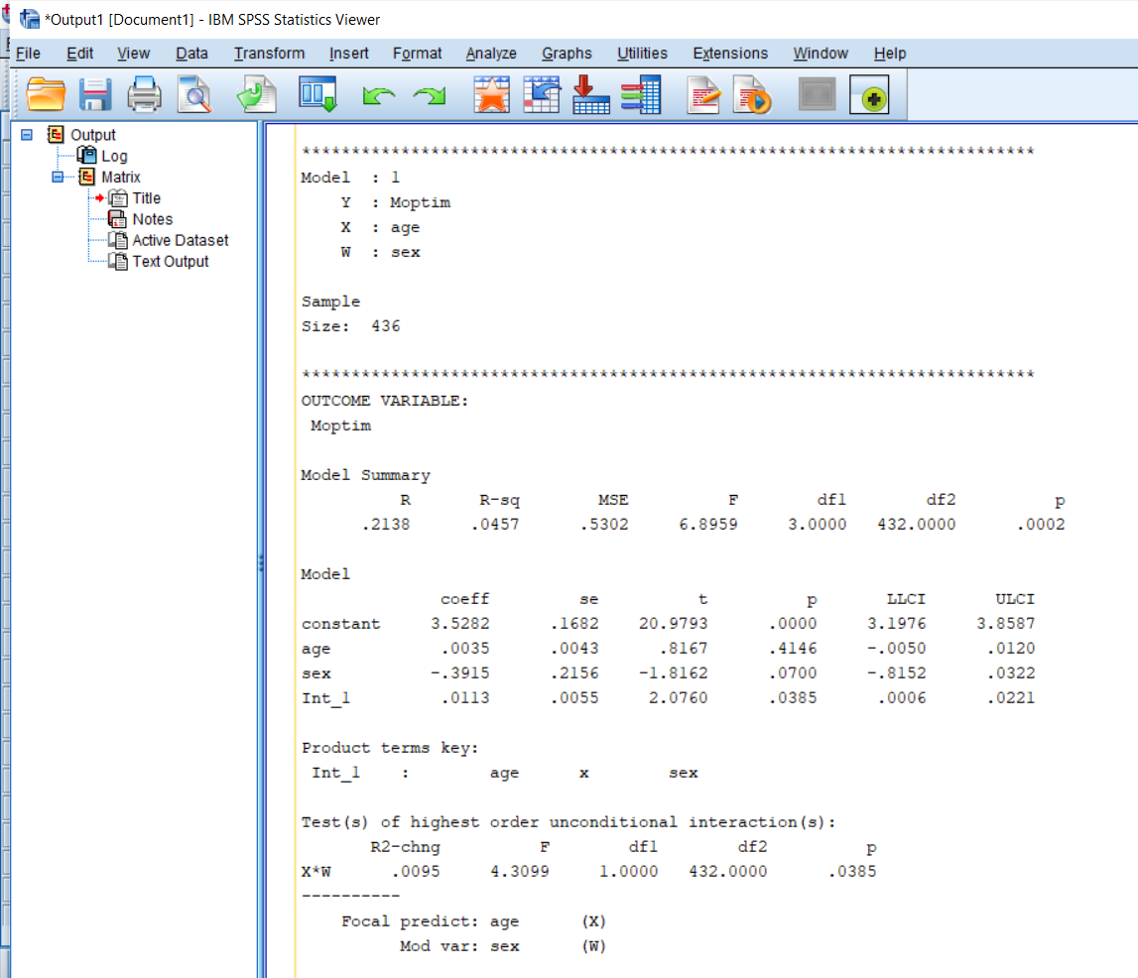
PROCESS Macro in SPSS Output

Slide 49
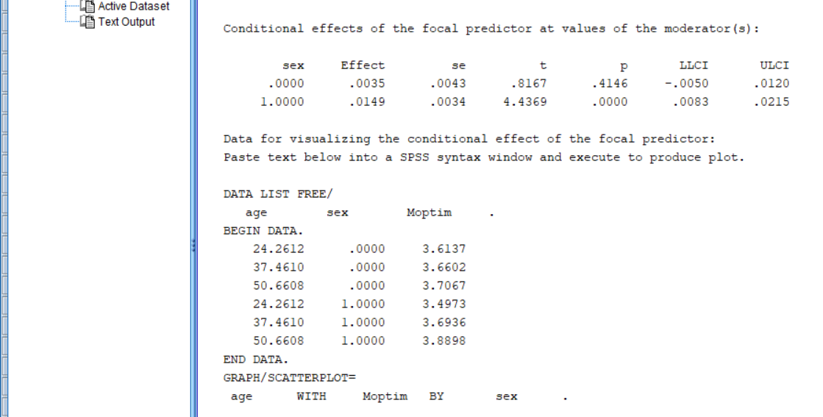
PROCESS Macro in SPSS Output

Slide 50
Covariates
You can include covariates in your analysis
Other IVs; continuous or dichotomous
Interpret B₁, B₂, and B₃ as “controlling for other variables in the model”
When graphing, set value of covariates to a meaningful value (typically, the mean or reference group); this will just contribute to the constant

Slide 51
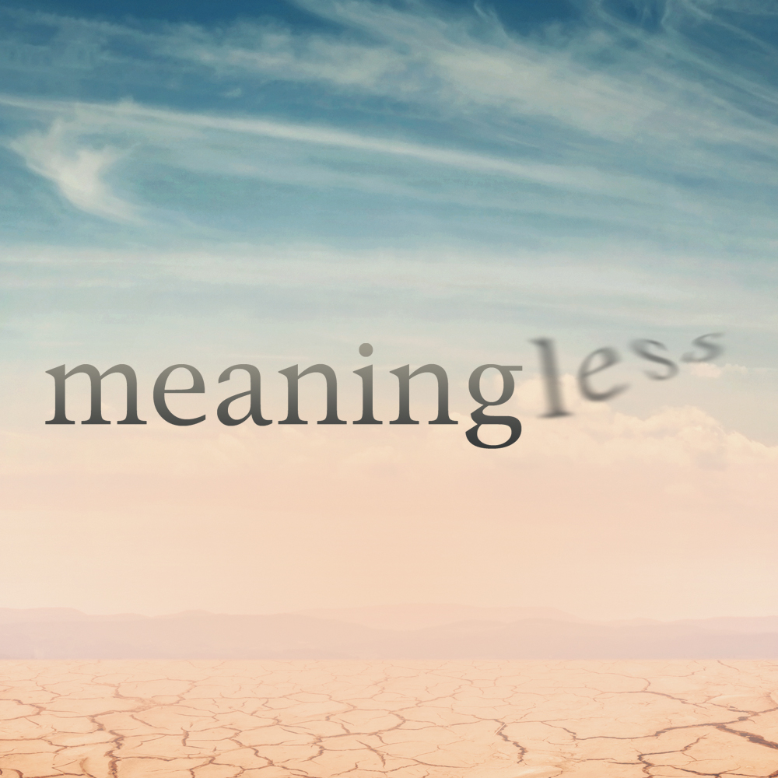
Interactions on their own
MEANINGLESS
Never look at XW without X and W also in the model

Slide 52
Higher-Order Interactions
Can include, e.g., 3-way interactions
Make sure to also include all simple effects and 2-way interactions
Interpretation:
Beta for 2-way interaction how much W changes the relationship between X and Y when Z = 0
Beta for 3-way interaction is how much W changes the relationship between X and Y with each unit increase of Z (phew!)
Easier to interpret with dummy codes
Make graphs for insight!

Slide 53
Interaction Effects in Multilevel Models
Overview
Example Formula
Grand- vs. Group-Mean Centering

Slide 54
Interaction in Effects in Multilevel Models (Overview)
Entered and (generally) interpreted in the same fashion as OLS regression models
Can include all possible combination of fixed effects predictors
Level 1 and Level 1
Level 1 and Level 2
Level 2 and Level 2
Continuous predictors, categorical predictors

Slide 55
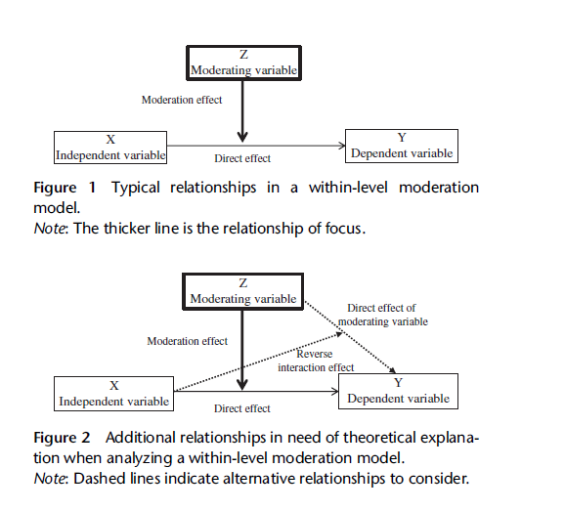
Moderation Figures from Andersson et al. (2014)

Slide 56
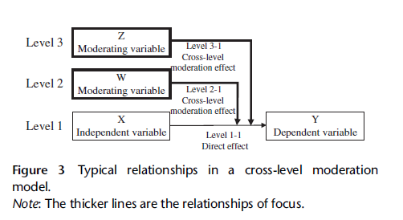
Moderation Figures from Andersson et al. (2014)

Slide 57
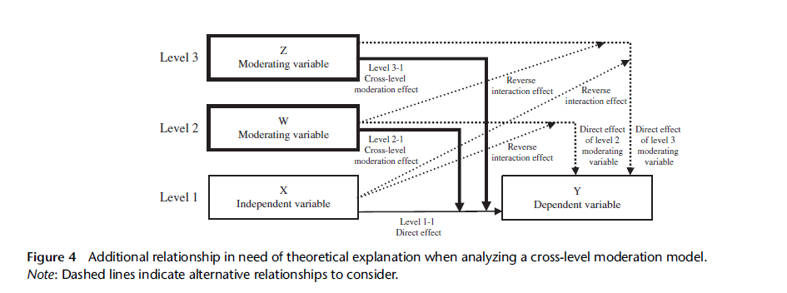
Moderation Figures from Andersson et al. (2014)

Slide 58
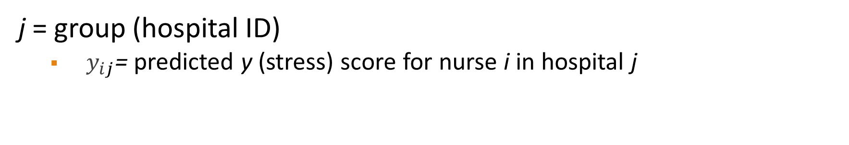
Example Formula (for Nurses.sav example in the tutorial slides this week)
$$y_{ij}=β_{0_{j}}+{β_{1}∗\left(age\right)+β_{2}∗\left(experience\right)+β_{3}∗(age∗experience)+ e}_{ij}$$
j = group (hospital ID)
$y_{ij}$= predicted y (stress) score for nurse i in hospital j

Slide 59

Random Intercept Included
$$y_{ij}=β_{0_{j}}+{β_{1}∗\left(age\right)+β_{2}∗\left(experience\right)+β_{3}∗(age∗experience)+ e}_{ij}$$
$$β_{0_{j}}=γ_{00}+ μ_{0_{j}}$$
$$y_{ij}=γ_{00}+ μ_{0_{j}}+{β_{1}∗\left(age\right)+β_{2}∗\left(experience\right)+β_{3}∗(age∗experience)+ e}_{ij}$$

Slide 60
Centering in Multilevel Models
Because data are structured at multiple levels, variables can be centered in multiple ways:
Grand-Mean Centering: subtracting individual scores from the overall sample mean
Group-Mean Centering: subtracting individual scores from their respective group/cluster mean
Debated topic about the appropriate use and interpretation of the effect of different centering methods in multilevel models.

Slide 61
Grand-Mean Centered Variables
Pretty straightforward interpretation: scores are relative to the overall sample average
Intercepts in the model(s) now represent the predicted score on the DV for somebody at average on X1, X2, X3,…

Slide 62
Group-Mean Centered Variables
The predictor(s) now take on the interpretation of relative X1, X2, X3…
E.g., relative income for country A, country B, country C,…

Slide 63
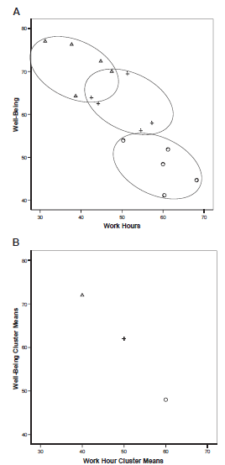
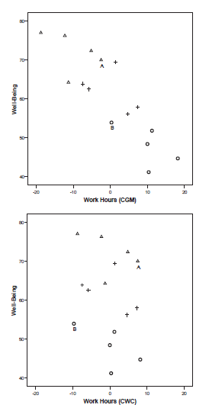
Figures from Enders & Tofighi (2007)

Slide 64
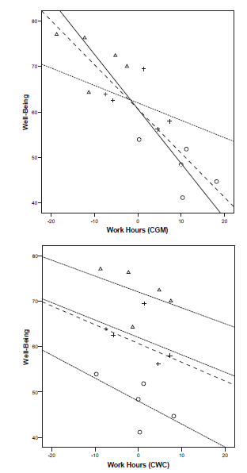
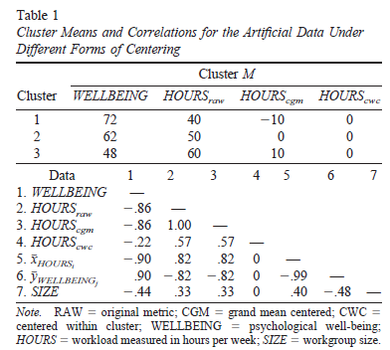
Figures from Enders & Tofighi (2007)

Slide 65
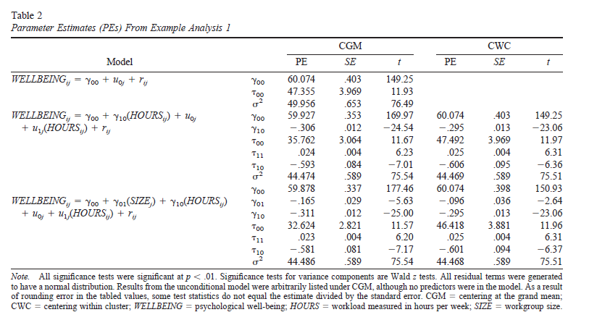
Figures from Enders & Tofighi (2007)

Slide 66
Enders & Tofighi (2007) Recommendations
Group-Mean Centering
Most appropriate when substantive research questions involve Level 1 predictor(s)
Grand-Mean Centering
Most appropriate when substantive research questions involve Level 2 effects and Level 1 variables are simply control variables in the model

Slide 67
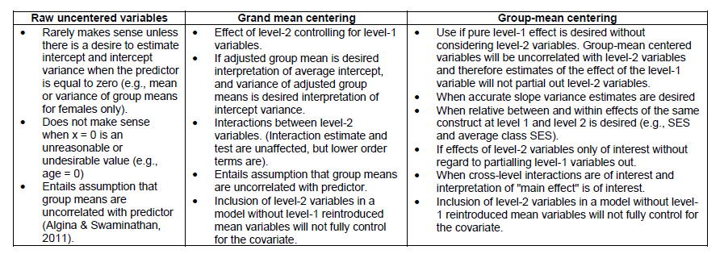
Other Recommendations (Newsom, 2017)

Slide 68
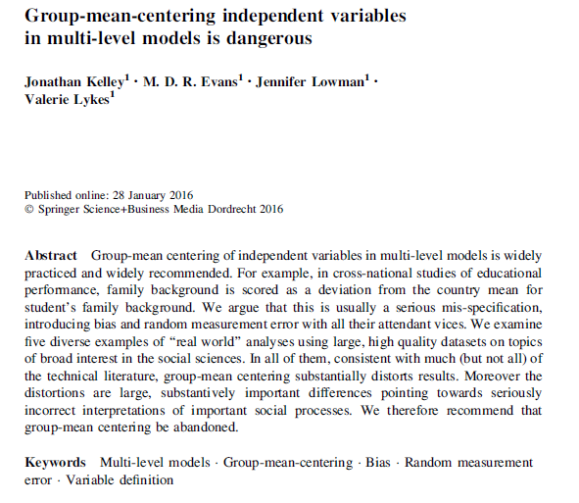
Other Perspectives
Notes:
Unbalanced data -> Use Sampling weights

Slide 69
Next Class
Lecture Topics:
Longitudinal Modeling in Multilevel Models
R
Longitudinal Modeling in R
Readings that will be discussed
Ntoumanis (2014), Wang & Maxwell (2015)
Contributing to your participation grade, make sure to respond to the Readings Feedback/Questions submission on Canvas
Homework #2 Due

